Slide 1
Enterprise Apps & Agents
POWER PLATFORM
Enterprise Code App → Dataverse → AI Builder → Copilot Studio Agent → Governed Automation → Capstone Project

Slide 2
Power Automate, REST actions and safe action design
Flows as agent tools
REST actions
Safe action design
Expose a cloud flow to the agent with a clear name, description and typed inputs and outputs.
Use the HTTP action or an OpenAPI-defined action. Prefer GET for reads; scope each write to one narrow operation.
Small single-purpose actions, validated inputs, idempotent writes, least-privilege identity, and clear error messages.
Notes:
An action is the unit of risk. Keep each one narrow, validated and reversible.

Slide 3
Custom connectors, Graph, Dataverse and Azure Functions
Custom connectors
Microsoft Graph
Wrap any REST API from an OpenAPI file with auth, so agents and flows call it governed and reusable.
Mail, calendar, Teams and files with delegated or app permissions. Request only the scopes you need.
Dataverse actions
Azure Functions
List, add, update rows and run custom actions with table-level security and business logic enforced.
Host custom logic: validation, orchestration, or calls to internal systems behind one secured endpoint.
Notes:
These are the preferred route: structured, testable, auditable and fast.

Slide 4

Computer Use architecture and appropriate use cases
Agent and instructions
Computer Use tool
Hosted browser or desktop
The agent sees screenshots, then clicks, types and scrolls in a loop until the task is done.
Good fit
Poor fit
Legacy apps and websites with no API, one-off data entry, and UI-only workflows.
Anything with an API, high-volume jobs, or irreversible and regulated actions without review.
Notes:
Computer Use is a fallback. It is slower and less deterministic than an API call.

Slide 5
Instructions, dynamic inputs and credential management
Instructions
Dynamic inputs
Credentials
State the goal, the allowed sites and apps, the steps, and what to do when stuck. Say what is out of scope.
Pass values per run from the conversation or a flow. Validate them and never hard-code data in instructions.
Store secrets in the platform credential store or Azure Key Vault. The model never sees passwords. Use service accounts with least privilege.
Notes:
Treat instructions like code: version them, review them and test them.

Slide 6
Allow-lists, human-in-the-loop, session replay and Purview audit
Allow-lists
Human-in-the-loop
Restrict the sites and apps the agent may open. Everything else is blocked.
Require approval before sending, paying, deleting or any step that cannot be undone.
Session replay
Purview audit
Review step-by-step screenshots and actions of each run to debug and verify behavior.
Agent activity is logged for compliance search, retention and investigations.
Notes:
Controls before the run (allow-lists), during (approvals) and after (replay and audit).

Slide 7
DLP, safe autonomy and preferring APIs
DLP policies group connectors as business or non-business and block risky combinations. Pick the safest path that works:
1. API or connector
2. Build the API
3. Computer Use
Default choice: governed, fast, deterministic.
Custom connector or Azure Function over the system.
Last resort, with allow-lists, approvals and audit.
Notes:
Autonomy is earned: start with approvals on, then relax as evidence builds.

Slide 8
Steps to Create a Custom Connector
Identify or build the API
Describe
the API
Use the connector
Certify/open source
You can define the custom connector to describe any REST API that is public (one that is available on the internet) or private (one that is only on your internal network).

Slide 9
Steps to Create a Custom Connector – Describe
Identify or build the API
Describe
the API
Use the connector
Certify/open source
For Power Apps and Power Automate to discover what triggers and actions are available from the API, you must identify them when you create your custom connector

Slide 10
Steps to Create a Custom Connector – Use
Identify or build the API
Describe
the API
Use the connector
Certify/open source
After they have been created in an environment, custom connectors can be used in the same way as built-in connectors
To use in other environments the connector definition needs to be exported from the environment where it was created and then imported into any environment that needs it

Slide 11
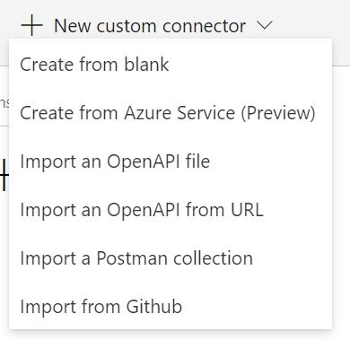
Describe the Connector
To define a connector’s actions and triggers, you need to describe the connector.
Notes:
Create from Blank - Manually create in the portal
Create from Azure Service - Export from Azure - If your API is built as an Azure App Service, Microsoft Azure Functions, or is managed by Microsoft Azure API Management, you can export from those services and it will automatically create the initial custom connector definition.
Import Open API definition - Importing version 2.0 is supported, but version 3.0 is not currently supported. Limited to 1MB.
Import Postman collection - Currently, you can use this approach with v1 collections.
Import from GitHub allows you to choose from the Certified or Custom folder of the Power Platform repository to import the definition. https://powerautomate.microsoft.com/en-us/blog/import-a-connector-from-github-as-a-custom-connector/

Slide 12
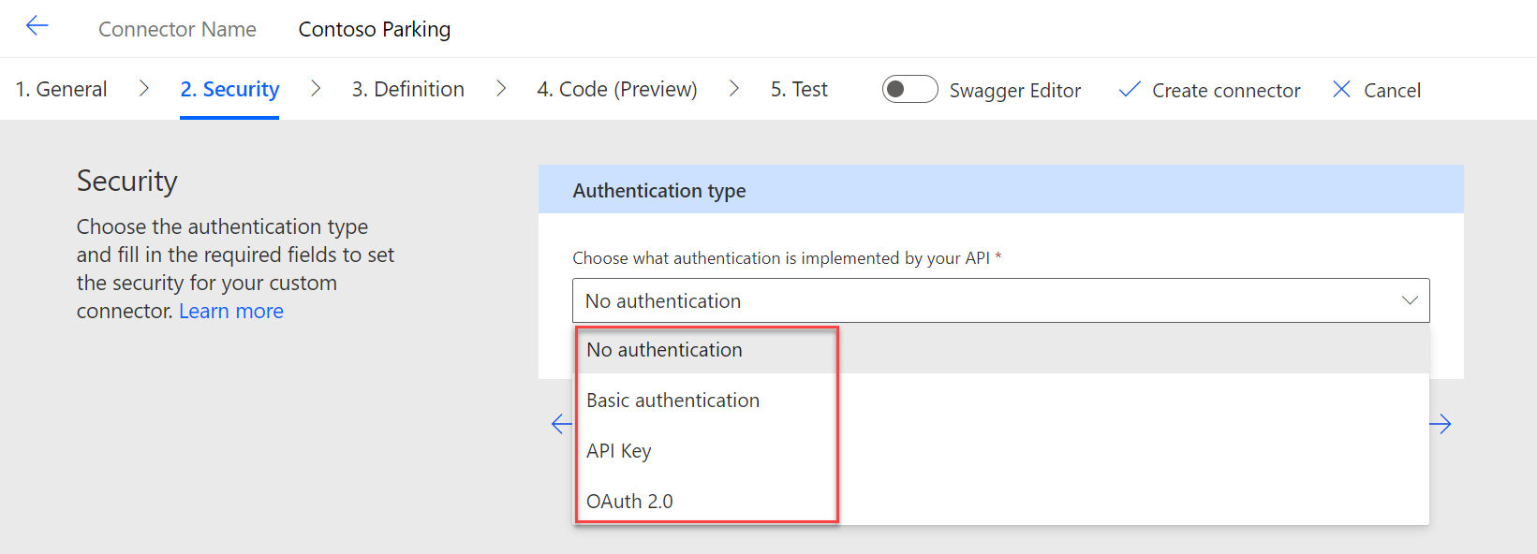
Work with Authenticated APIs
The custom connector architecture supports working with authenticated APIs.
No authentication
Basic authentication
OAuth 2.0
API key
Notes:
The custom connector architecture supports working with authenticated APIs. When you define the custom connector, you will identify how it should authenticate to the API. Authentication choices support anonymous, password protected, OAuth 2.0, and API key access.
No authentication - This choice is for APIs that allow anonymous access, and it is the default if you don't configure a specific authentication type.
Basic authentication - This choice is for APIs that require a user and password to be sent with each request.
OAuth 2.0 - OAuth 2.0 is the industry-standard protocol for authorization. This option can be configured for any API that uses OAuth 2.0.
API key - An API key is a token that a client provides when making API calls. The API publisher typically provides the key, and it must be included in each request from the custom connector.

Slide 13
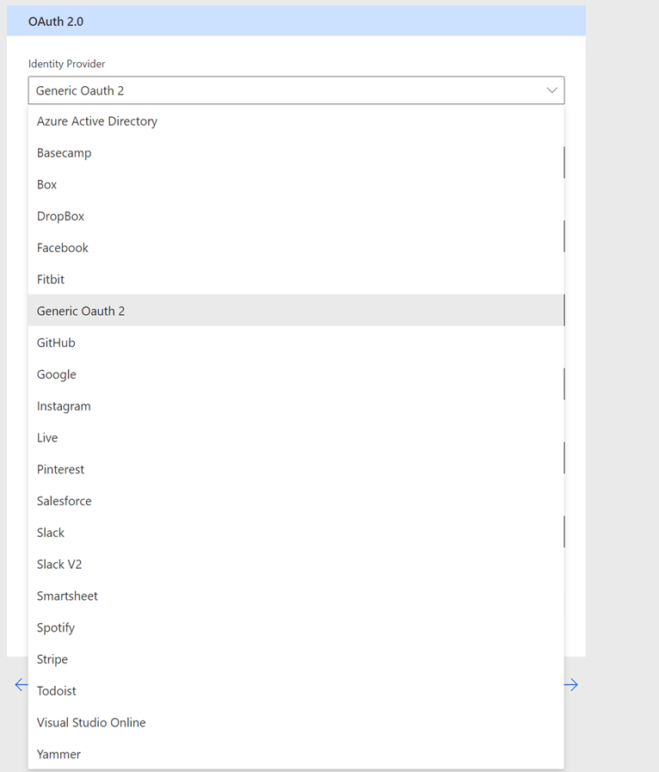
Work with OAuth 2 Authenticated APIs
Notes:
Prebuilt OAuth 2configurations are available for you to select from for Microsoft services like Azure Active Directory (Azure AD), GitHub, and Azure DevOps. Similar prebuilt configurations are available for other services like Dropbox, Slack, Stripe, and more. The prebuilt configurations simplify what you need to provide to configure the identity provider.

Slide 14

Demo
POWER PLATFORM
H1. Banking: call a core-banking API through a custom connector
H2. Supply Chain: automate a restricted logistics portal task
H3. Finance: design audited posting into an API-less accounting system
Notes:
Welcome. This deck walks through what you need before building your first Power Apps Code App, then the six commands that take you from a starter template to a deployed app.

Slide 15
Closing slide
Thank you

